Slide 1
Project 6
Shopify Analysis Using Power BI

Slide 2
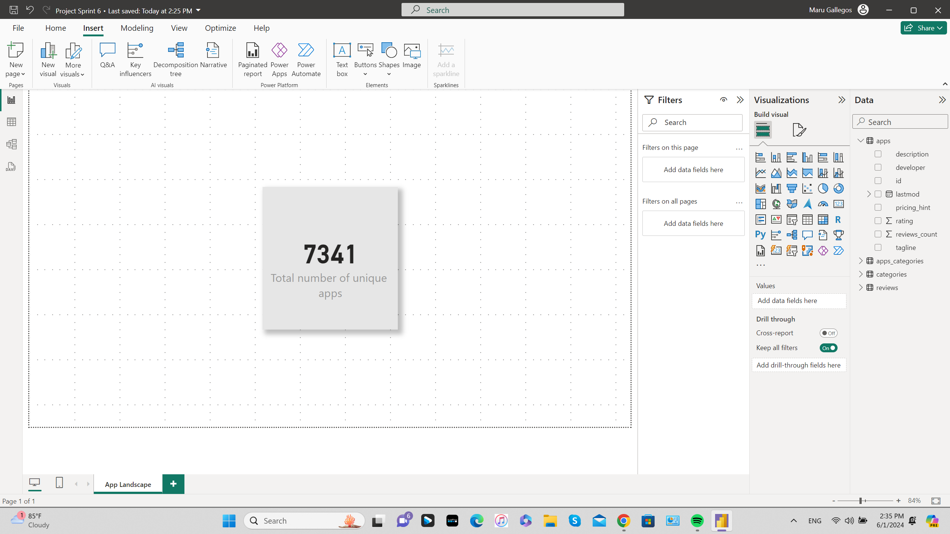
KPI Card

Slide 3
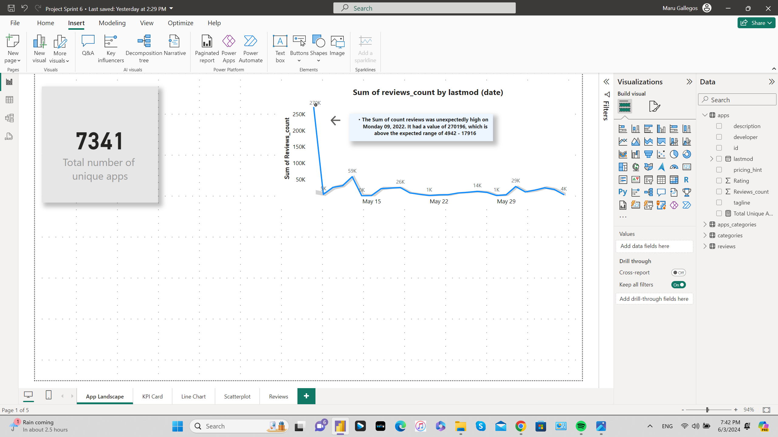
Line Chart Sum of review count by lastmod

Slide 4
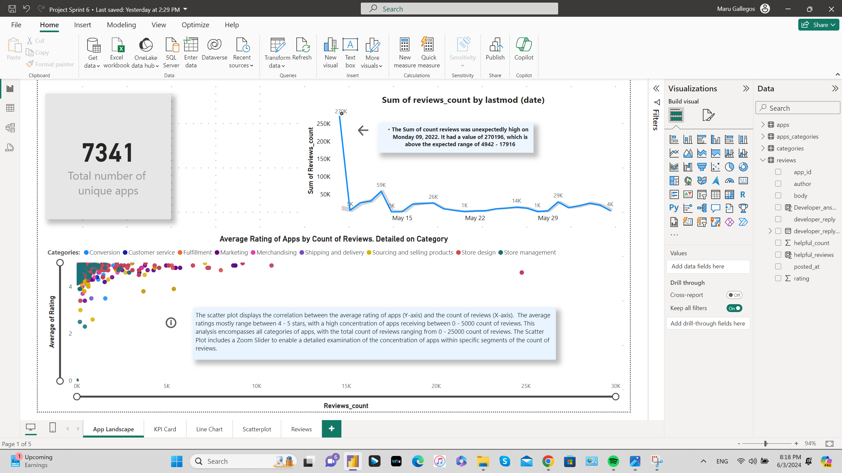
Average Rating of Apps by Count of Reviews detailed on Category

Slide 5
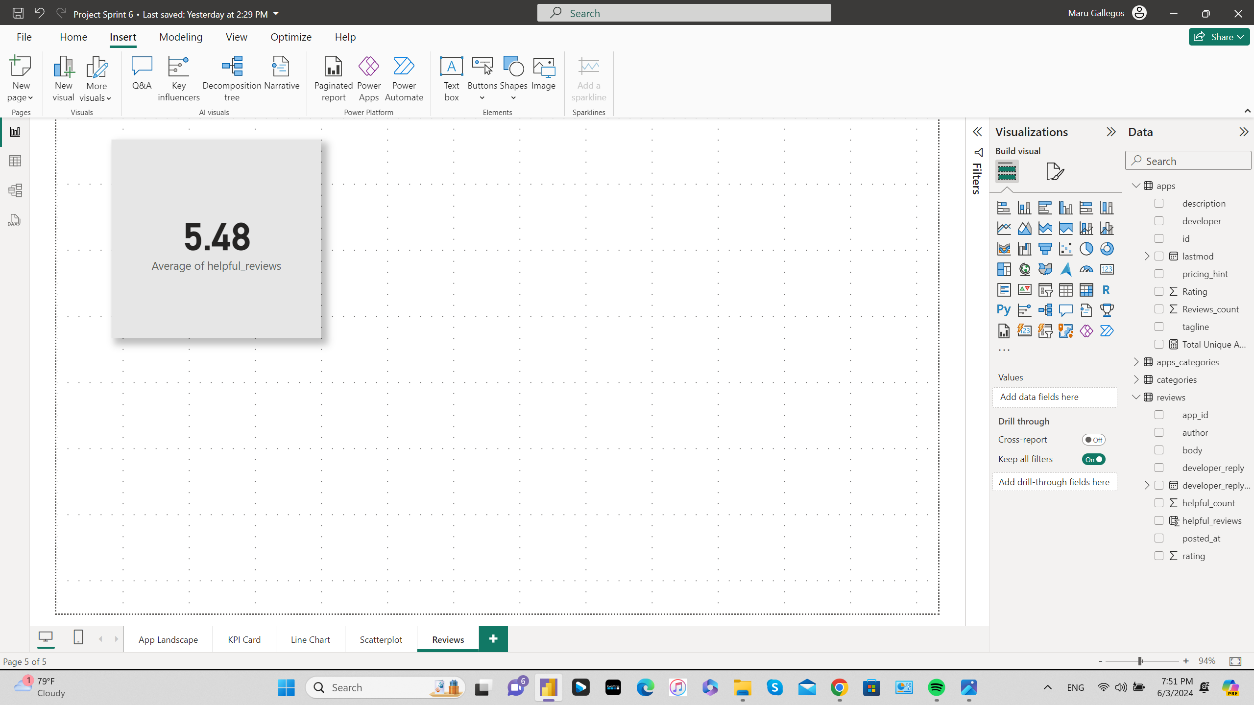
Card Average Value of helpful_reviews column

Slide 6
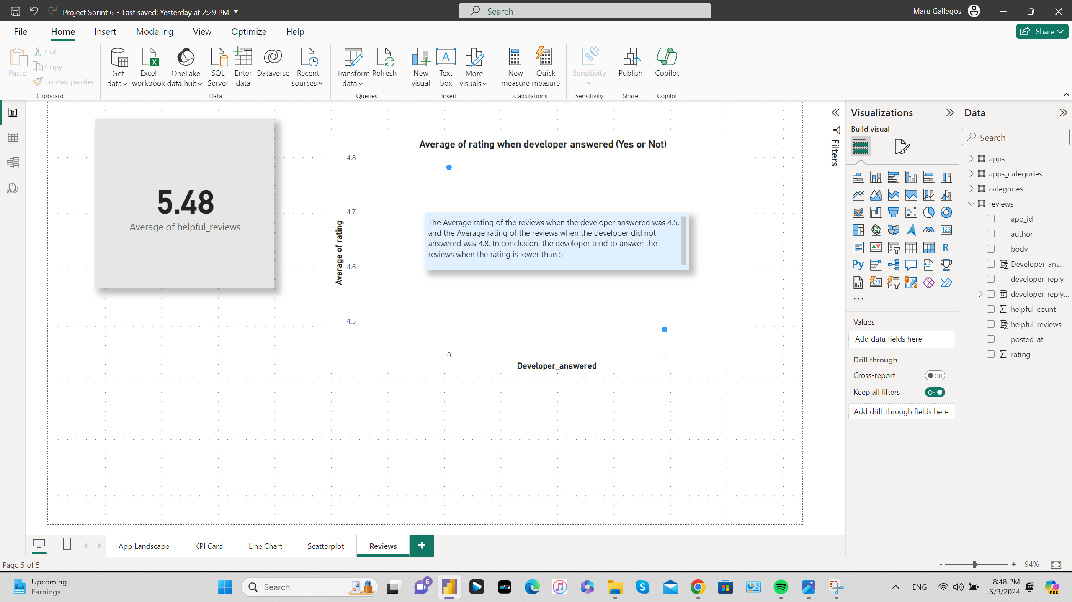
Average of Rating when Developer answered ( YES or NOT)

Slide 7
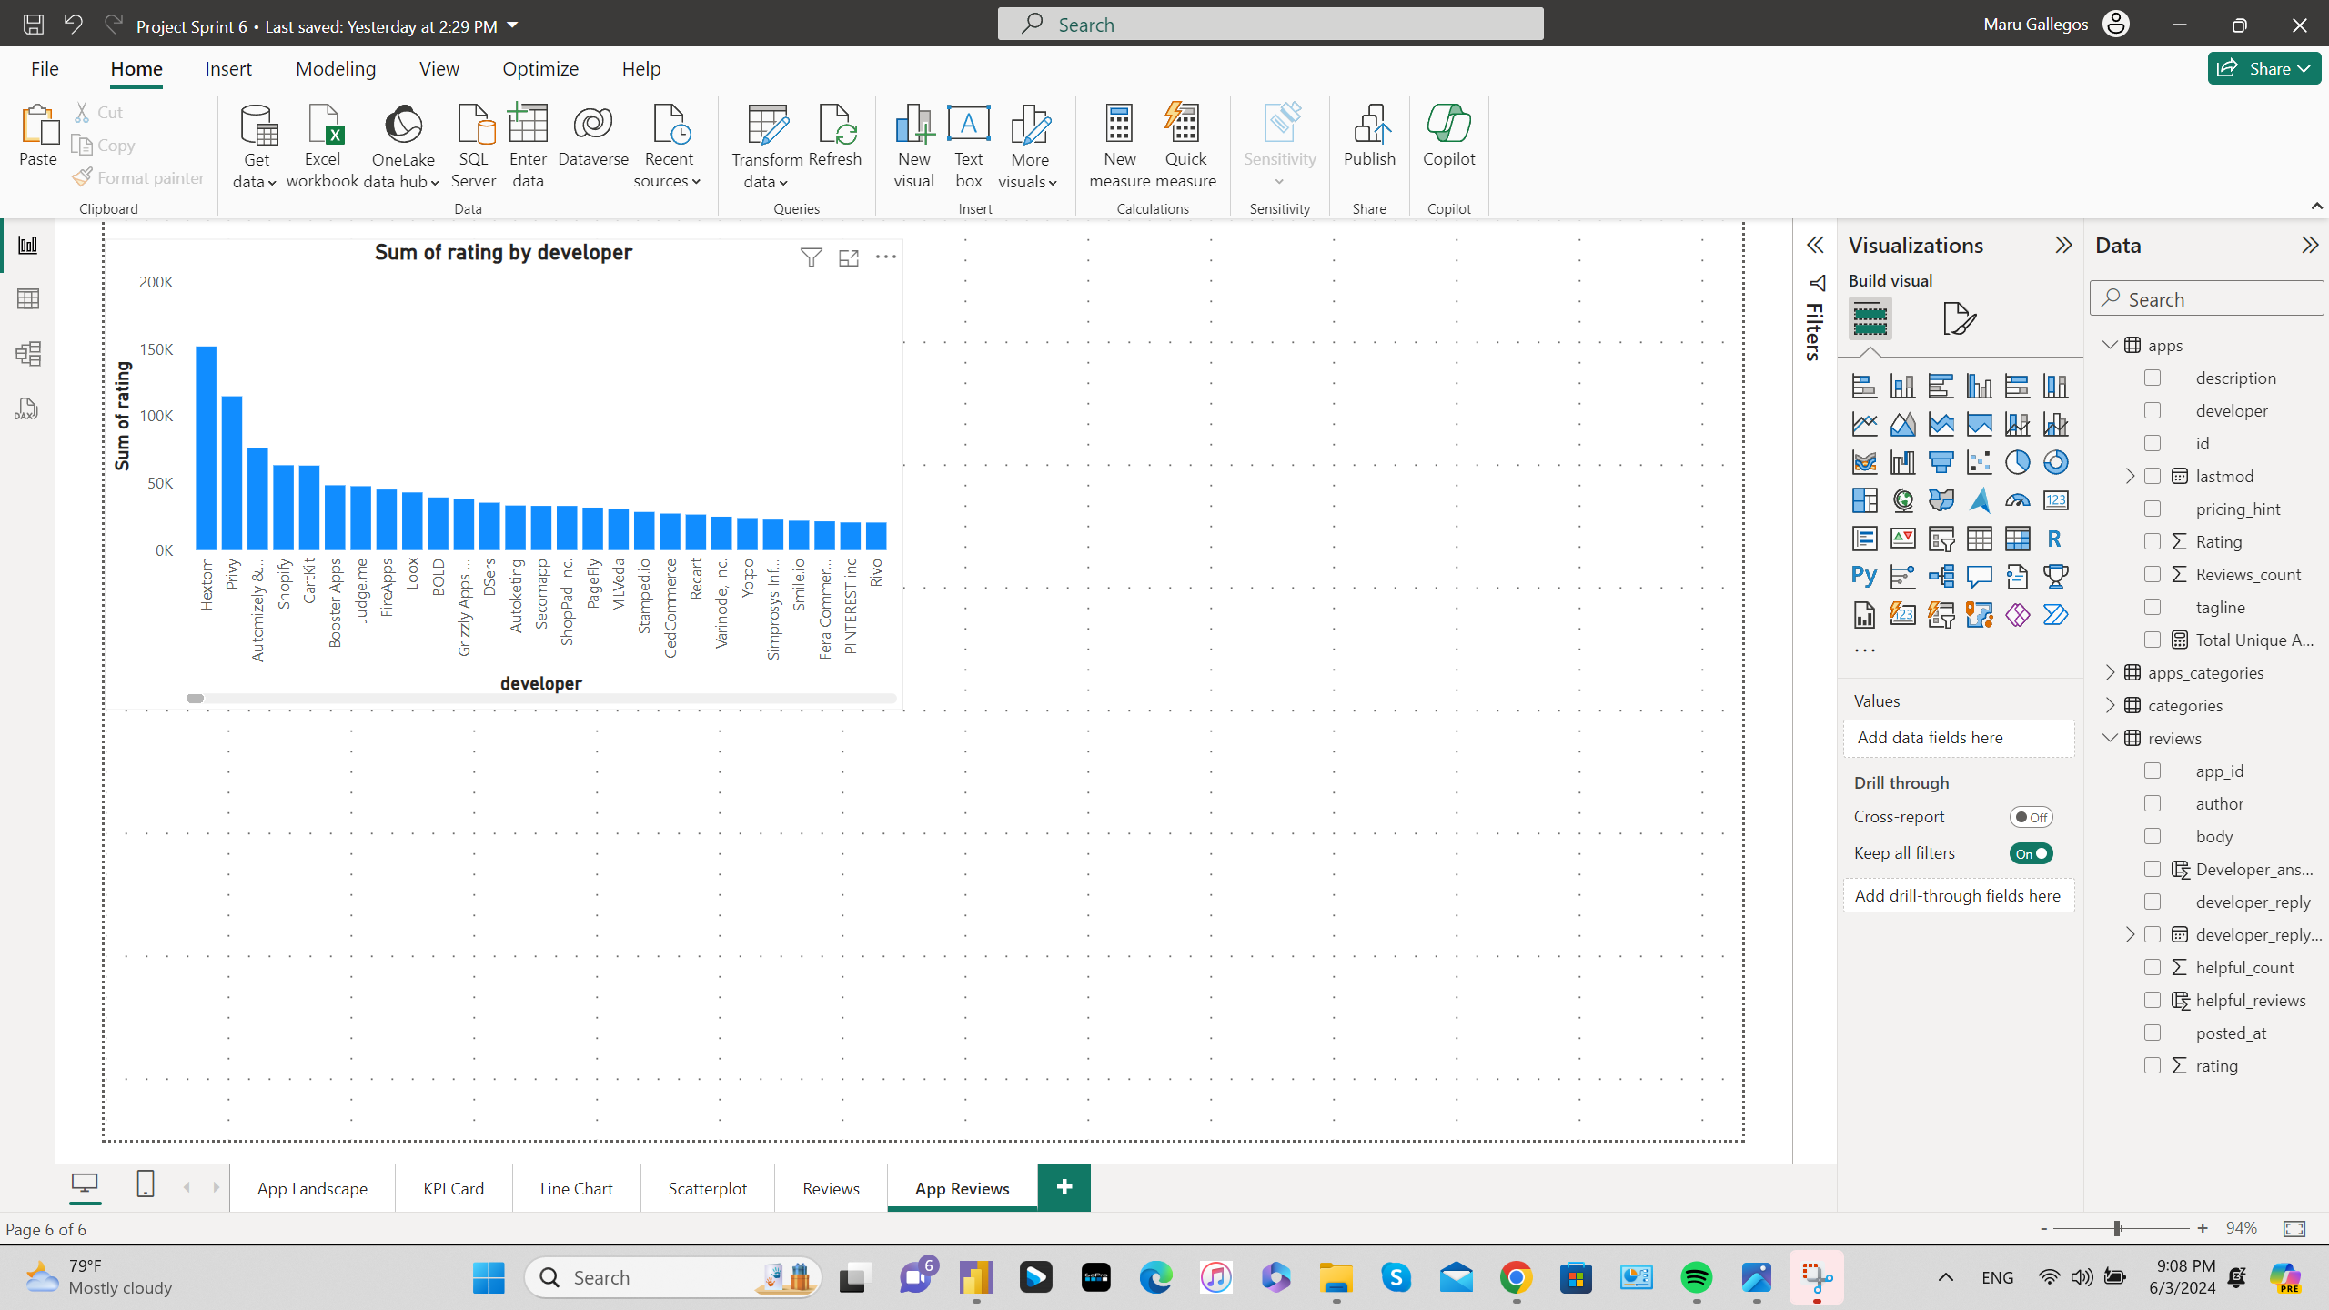
Screenshot Sum of rating by developer

Slide 8
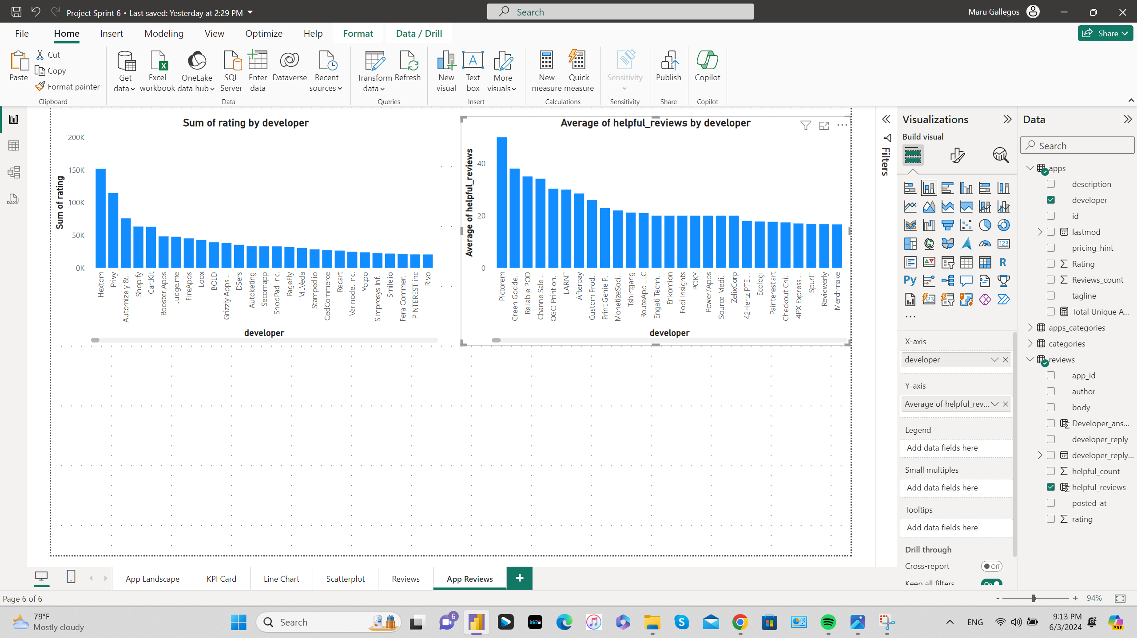
Average of helpful_reviews by Developer

Slide 9
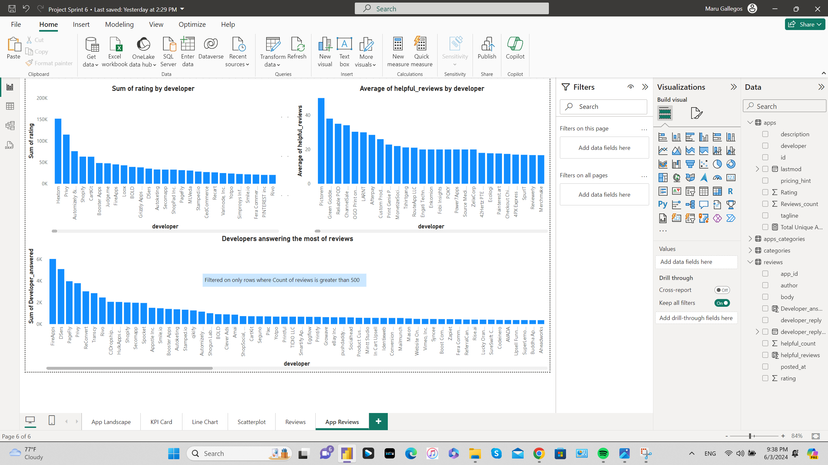
Developers answering the most of reviews

